Slide 1
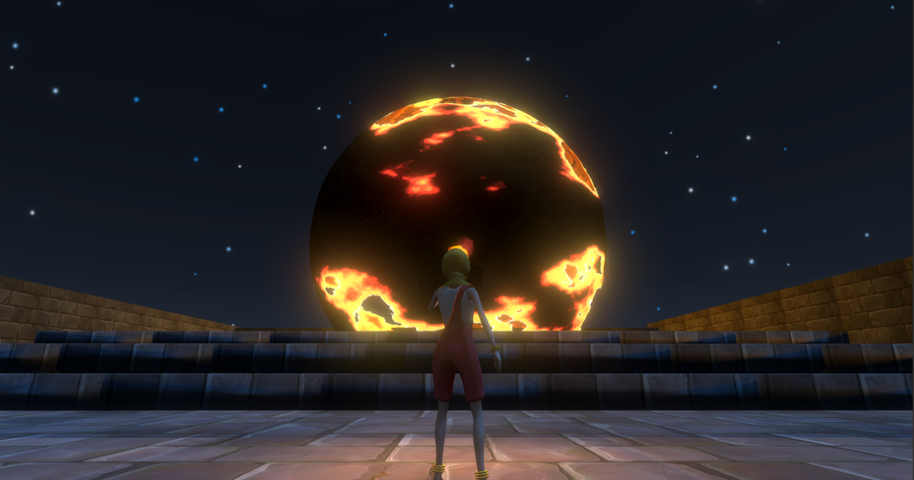
Rayha’s Poem
By Gordon Lee and Mostafa Haque

Slide 2
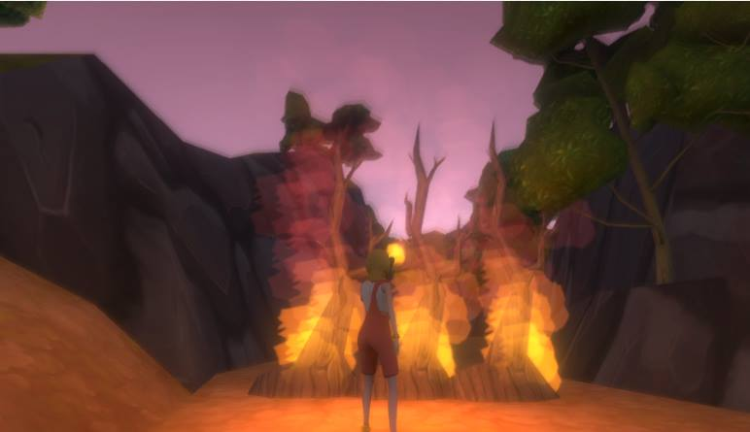
What is it
A third person narrative platformer about a little girl running away to a mythical kingdom to escape child marriage
Notes:
A third person narrative platformer about a little girl running away to a mythical kingdom to escape child marriage.

Slide 3
Themes
Child marriage
South Asian fairytales
Fairyland as a metaphor

Slide 4
Iterative Process
Multiplayer prototype
Artful Dodgers
Enuma Elish
The Bride (Singleplayer)
Rayha’s Poem

Slide 5
Initial Objectives
Non-violent
Co-operative
Non-standard setting

Slide 6
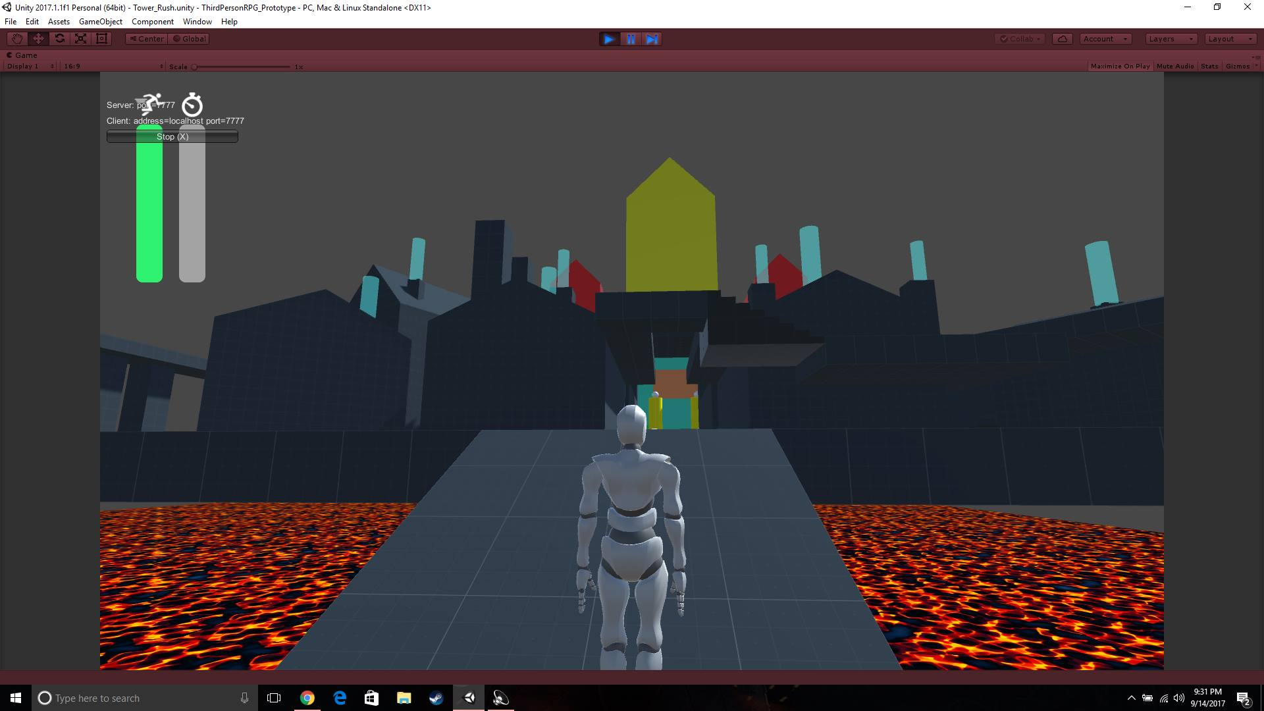
Multiplayer prototype (Gordon)

Slide 7
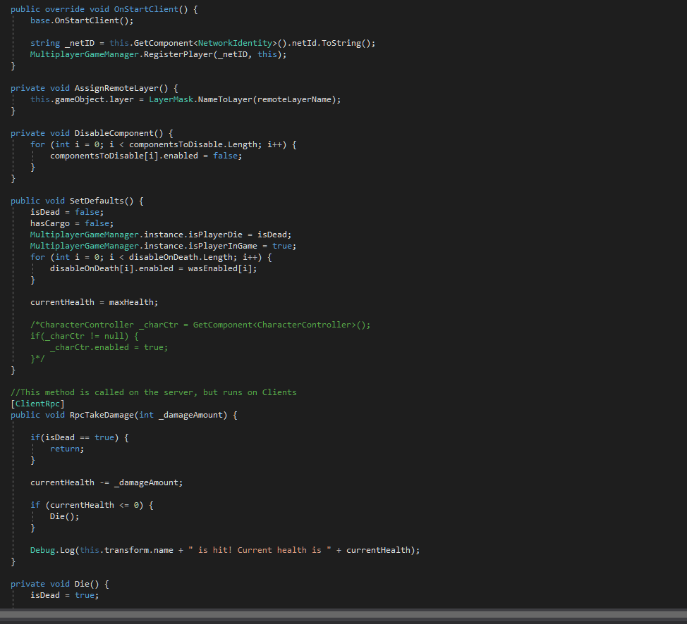
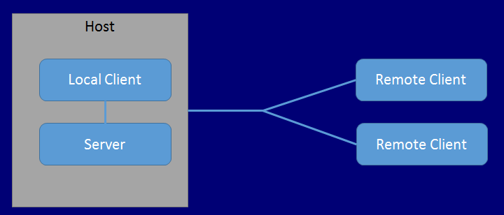
Multiplayer prototype (Gordon)
Notes:
Challenge a concept we’ve never done before. Solving problem in programming Network Based Multiplyer game. Too many compete multiplayer games, we are trying to emphasize cooperation and story telling in a Multipler game.

Slide 8
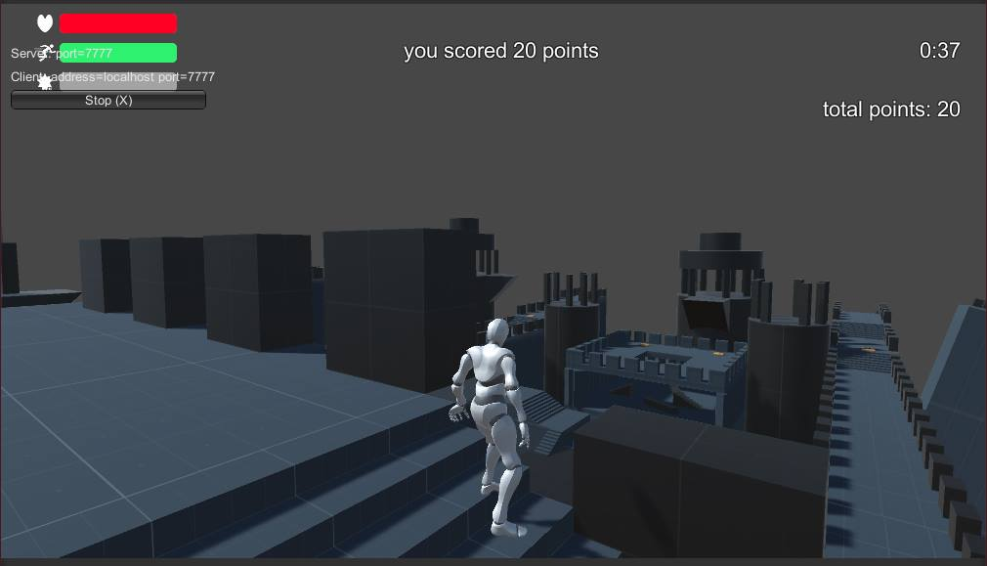
Multiplayer prototype (Gordon) - Artful Dodgers

Slide 9
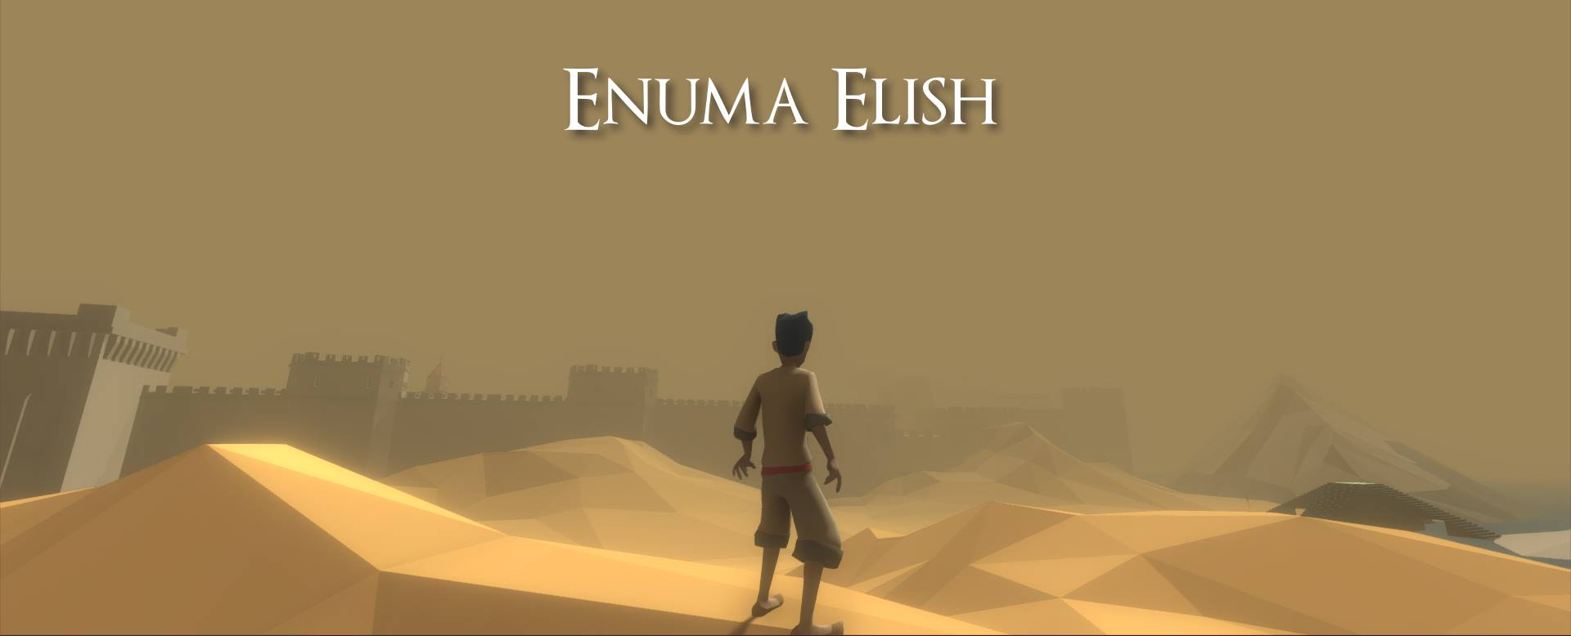
Enuma Elish (Mostafa & Gordon)
Notes:
The first character design implemented to the prototype. We made “Enuma Elish”.

Slide 10
Single player pivot
Network issues
Lack of focused design
Not a story we wanted to tell
Notes:
We needed a story – a narrative

Slide 11
New Objective
Non-violent
Non-standard setting

Slide 12
New Narrative Direction
Child marriage law in Bangladesh
Highlighting South Asian fairytales
Framing the narrative in a non-Eurocentric fashion

Slide 13
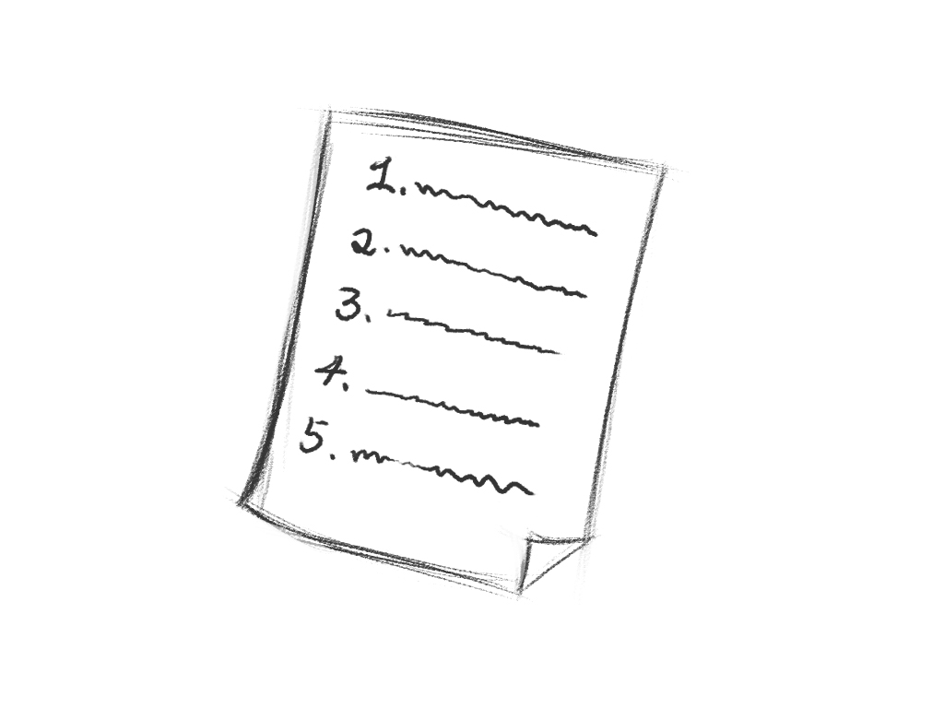
How did we develop the Story? (Gordon)
Notes:
The story structure. The key points representing south Asian fairytales and child marriage.

Slide 14
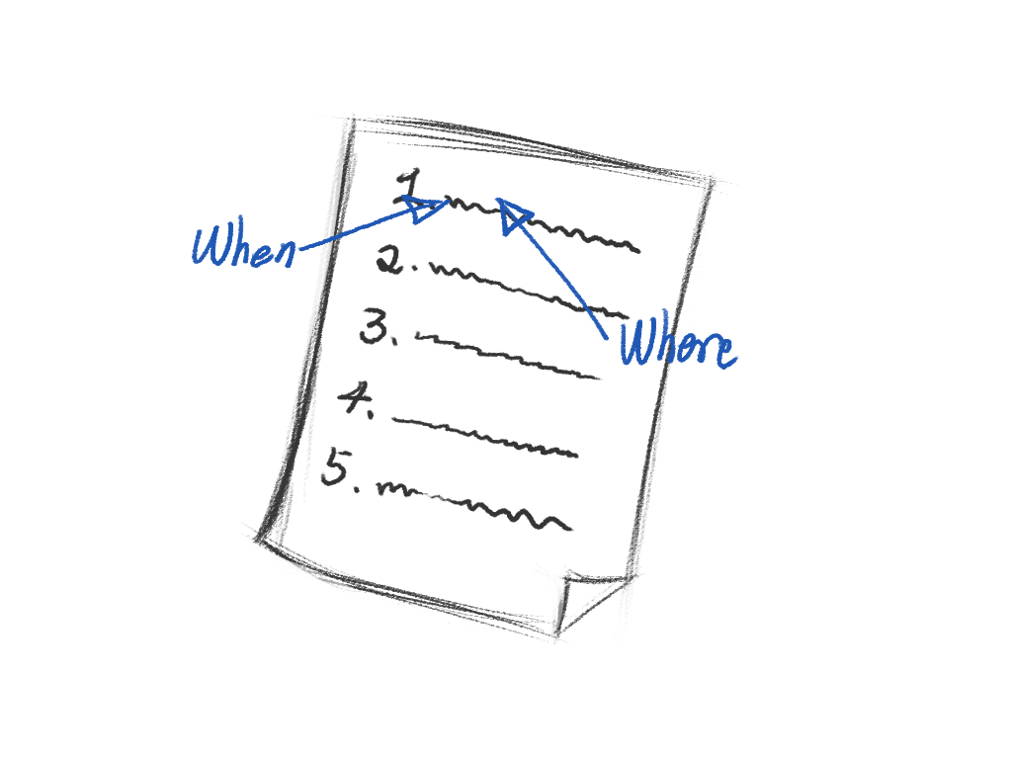
How we developed the Story? (Gordon)
Notes:
We discussed the background culture and set when and where the story happened.

Slide 15
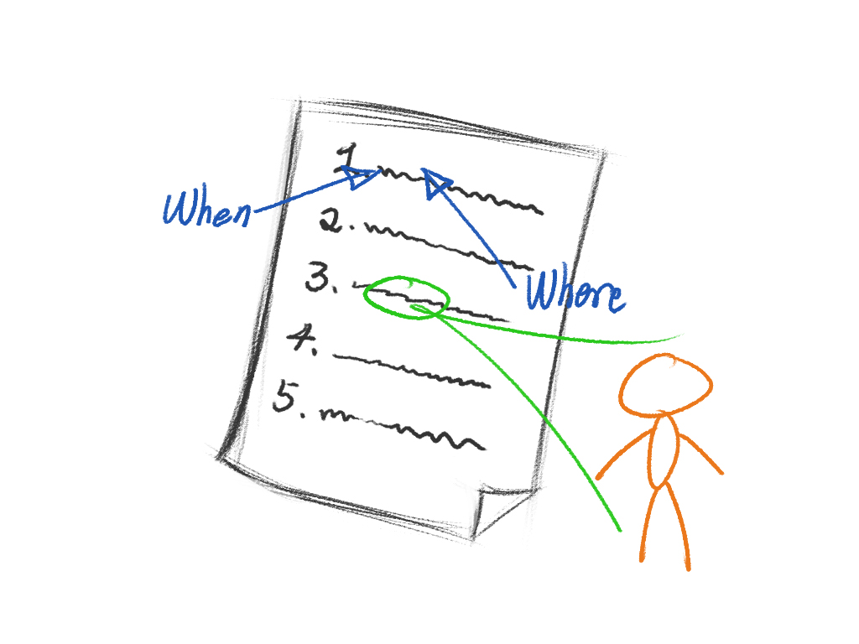
How we developed the Story? (Gordon)
Notes:
Who is in the story, who will be the appropriate character to match the story. One or more characters should be in the story.

Slide 16
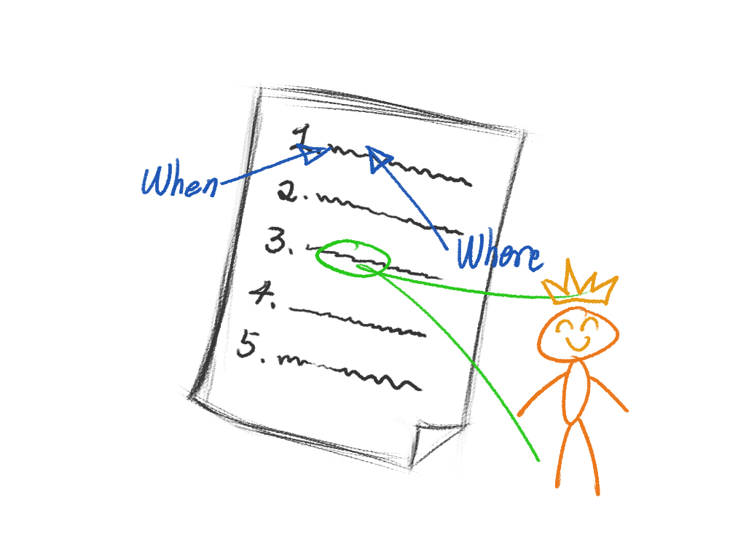
How we developed the Story? (Gordon)
Notes:
we set the protagonist – the bride, who will tell her story to the player.

Slide 17
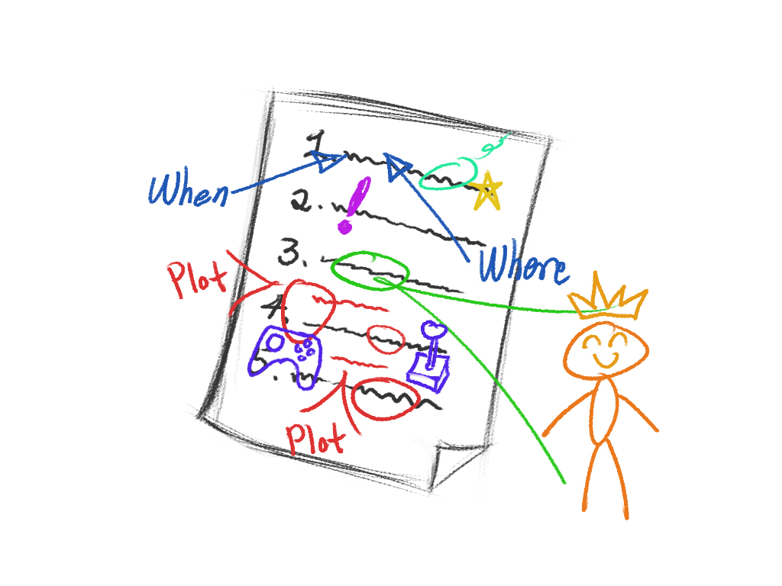
How we developed the Story? (Gordon)
Notes:
We added fun plots – explore, collect, puzzle solving in the story. To make a story can be a game.

Slide 18
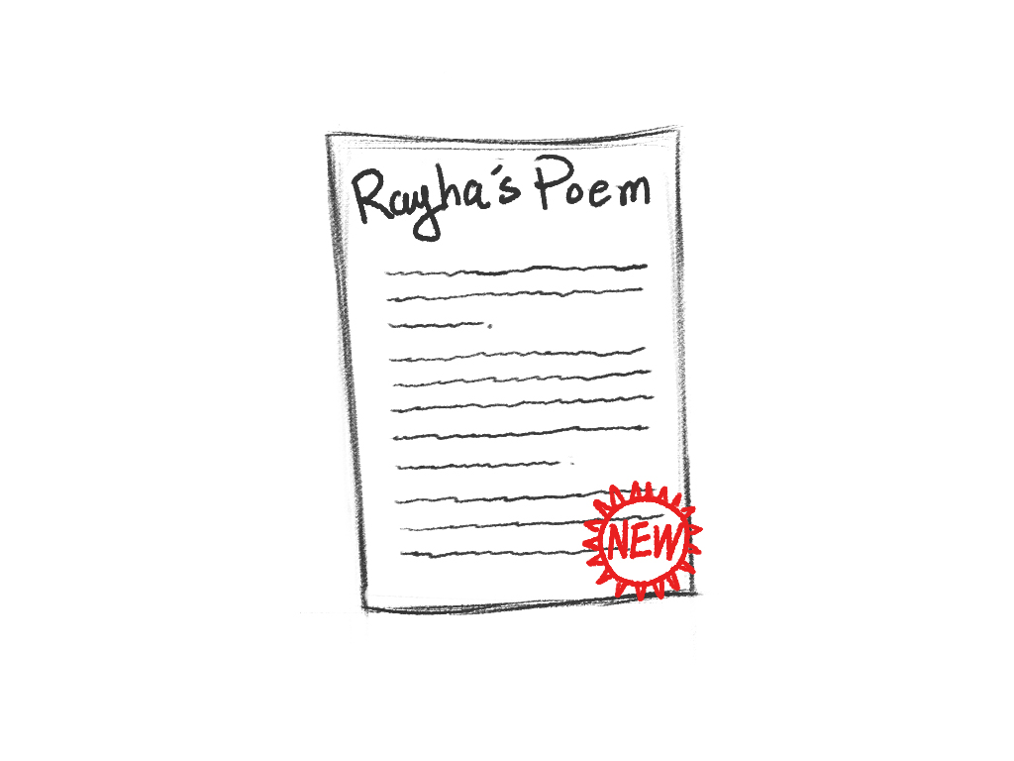
How we developed the Story? (Gordon)
Notes:
Finally, we had our story.

Slide 19
Visual Design and Progression in a 3D environment (Gordon)
Old style
New style
Why
Notes:
Visualize in 3D - Design the World
Terrain
Forest
Ruined castle
Visualize in 3D - Design the Character
As the game development
As the story development

Slide 20
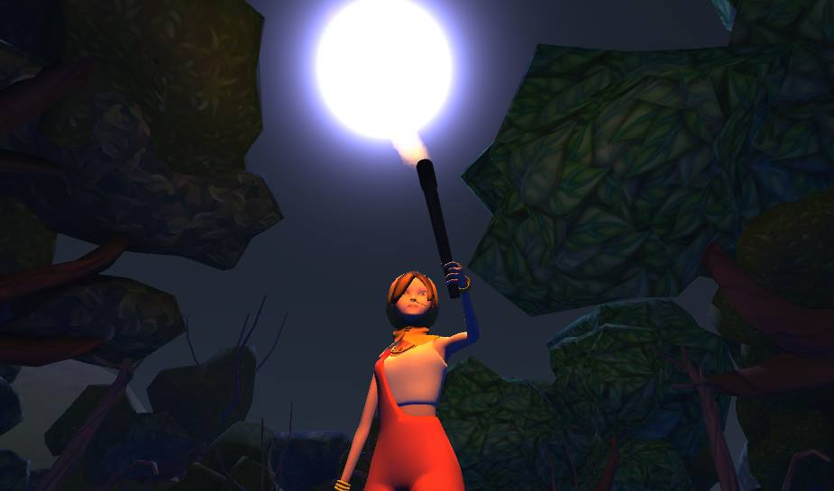
The Bride - Single player prototype
Notes:
I wanted to talk about this issue because child marriage laws in Bangladesh changed

Slide 21
Final Product – Rayha’s Poem
//Here should be a link to the local video

